Slide 1


Slide 2
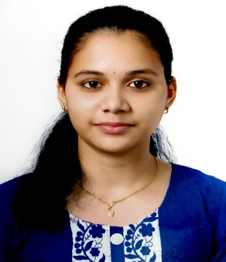
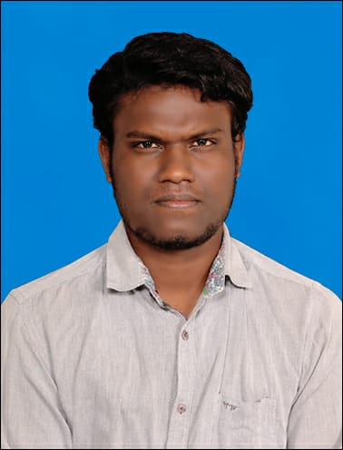
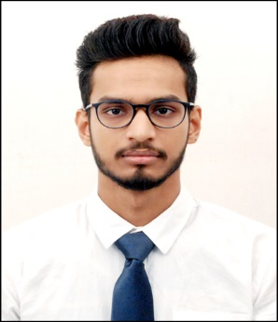
Project Highlights
Project Name : Little Flora Pre School
Team Size : 3
BU Mentor Name : Mentor PS#
Team Members Details (Professional Stamp Size Photo with few lines of individual briefing
Pratheeksha J
99002533
2009MYSSPSB1
BE–Information Science & Engineering
C, C++,JAVA, MySQL
M Parthiban
99002532
2009MYSSPSB1
M Tech – Computer Science & Engineering
C++, C#, MySQL
Swarnim Shikhar
99002521
2009MYSSPSB1
BE–Information Science & Engineering
C++, Python

Slide 3
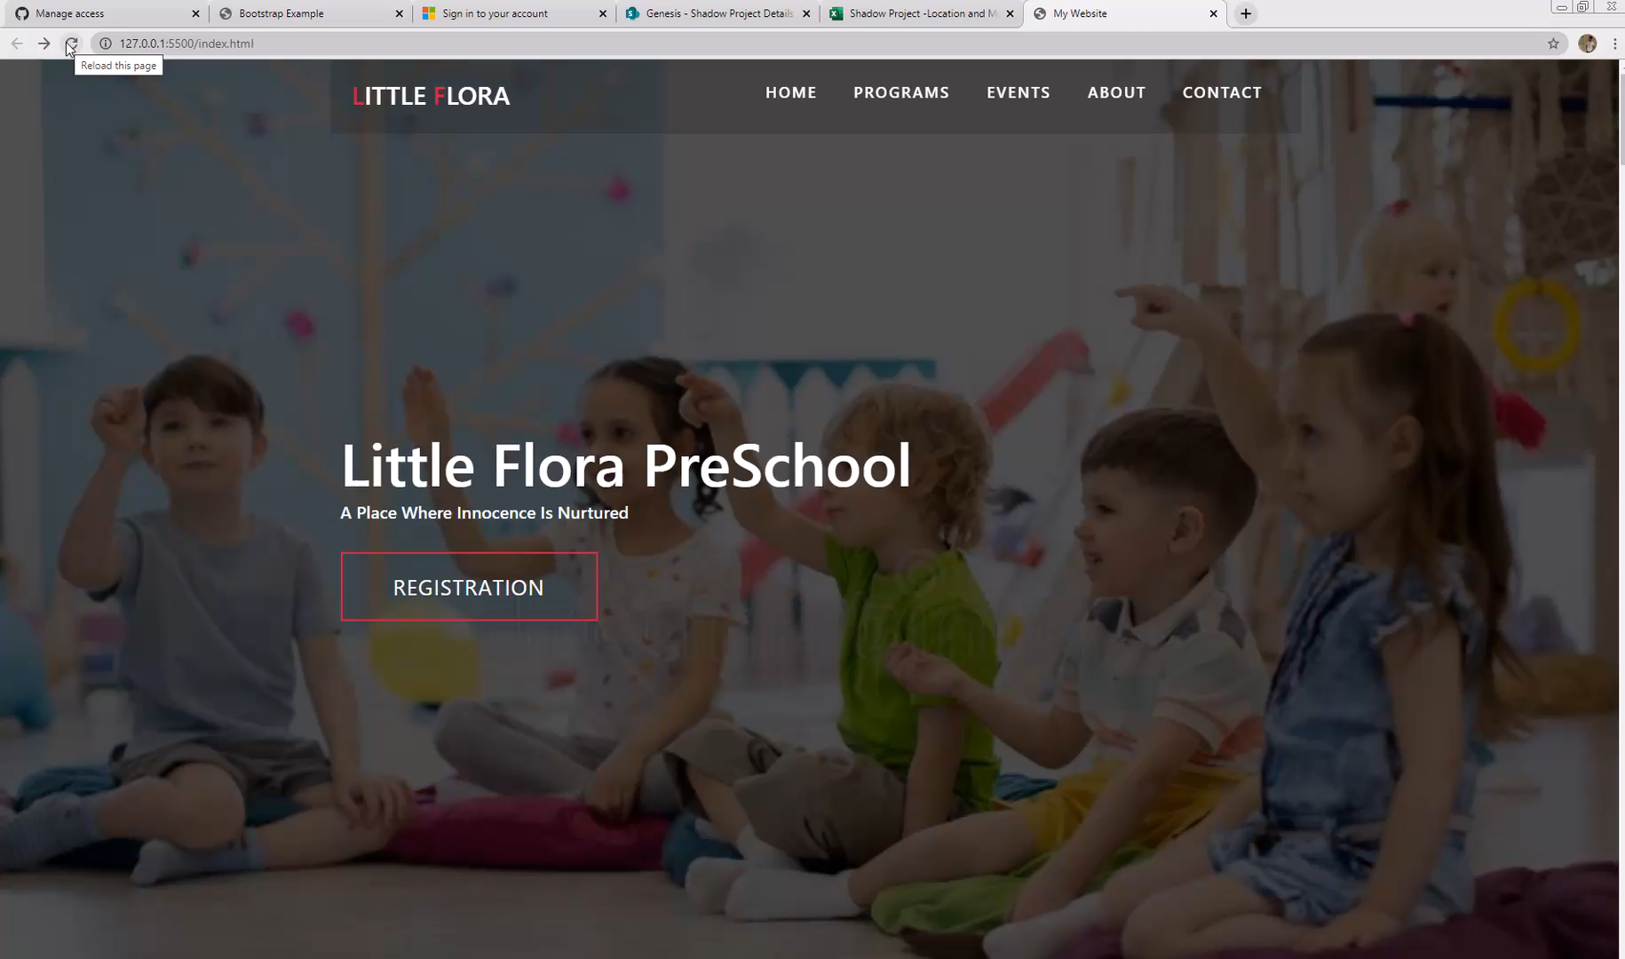
Project Video Snippet

Slide 4
Future development that can be implemented further
The project can be connected to backend and the website can be hosted.
Database can be connected to store the registration details.
The project can be extended to add new functionalities such as submitting school fees, display results of children, E-notice boards etc.

Slide 5


Thank You !

